Slide 1
Introduction to Database
CHAPTER 3
SQL
Data Definition
Basic Query Structure
Set Operations
Aggregate Functions
Null Values
Nested Subqueries
Complex Queries
Views
Modification of the Database
Joined Relations**
3-<number>

Slide 2
History
IBM Sequel: language developed as part of System R project at the IBM San Jose Research Laboratory
Renamed Structured Query Language (SQL)
ANSI and ISO standard SQL:
  SQL-86
  SQL-89
  SQL-92
  SQL:1999 (language name became Y2K compliant!)
  SQL:2003
Commercial systems
  offer most, if not all, SQL-92 features,
  plus varying feature sets from later standards and
  special proprietary features.
  Not all examples here may work on your particular system.
應允的
專有的
3-<number>
Notes:
?例证

Slide 3
3.1 Background of SQL
SQL (Structure Query Language):
  the most influential query language
  a combination of relational algebra and relational calculus constructs.
  Developed by IBM for System R at Almaden Research Lab,
  Originally called Sequel
  ANSI standard: System may not support all features
Parts of SQL
  DDL (p.77)
  DML (p. 80)
  View Definition (p.99)
  Embedded SQL and Dynamic SQL (p.134, 137)
  Integrity (p.126)
  Authorization (p.133)
  …
3-<number>

Slide 4
Example: Banking Database
Banking Database: consists 6 relations:
  branch (branch-name, branch-city, assets)
  customer (customer-name, customer-street, customer-city)
  account (account-number, branch-name, balance)
  loan (loan-number, branch-name, amount)
  depositor (customer-name, account-number)
  borrower (customer-name, loan-number)
3-<number>

Slide 5

E-R Diagram for a Banking Enterprise, p.240
3-<number>

Slide 6






Example: Banking Database
1. branch
2. customer
3. depositor
分公司
客戶(存款戶,貸款戶)
存款戶
4. borrower
貸款戶
5. account
存款帳
6. loan
貸款帳
3-<number>

Slide 7

Example: Banking Database (cont.)
A Banking Enterprise
3-<number>

Slide 8
3.2 Data Definition
DDL can specify: a set of relations and information about each relation, including:
  The schema for each relation.
  The domain of values associated with each attribute.
  Integrity constraints
  The set of indices to be maintained for each relations.
  Security and authorization information for each relation.
  The physical storage structure of each relation on disk.
create table branch
(branch-name char(15),
branch-city char(30),
assets integer,
primary key (branch-name),
check (assets >= 0))
include create table in EX
3-<number>
Notes:
？后三个的例证

Slide 9
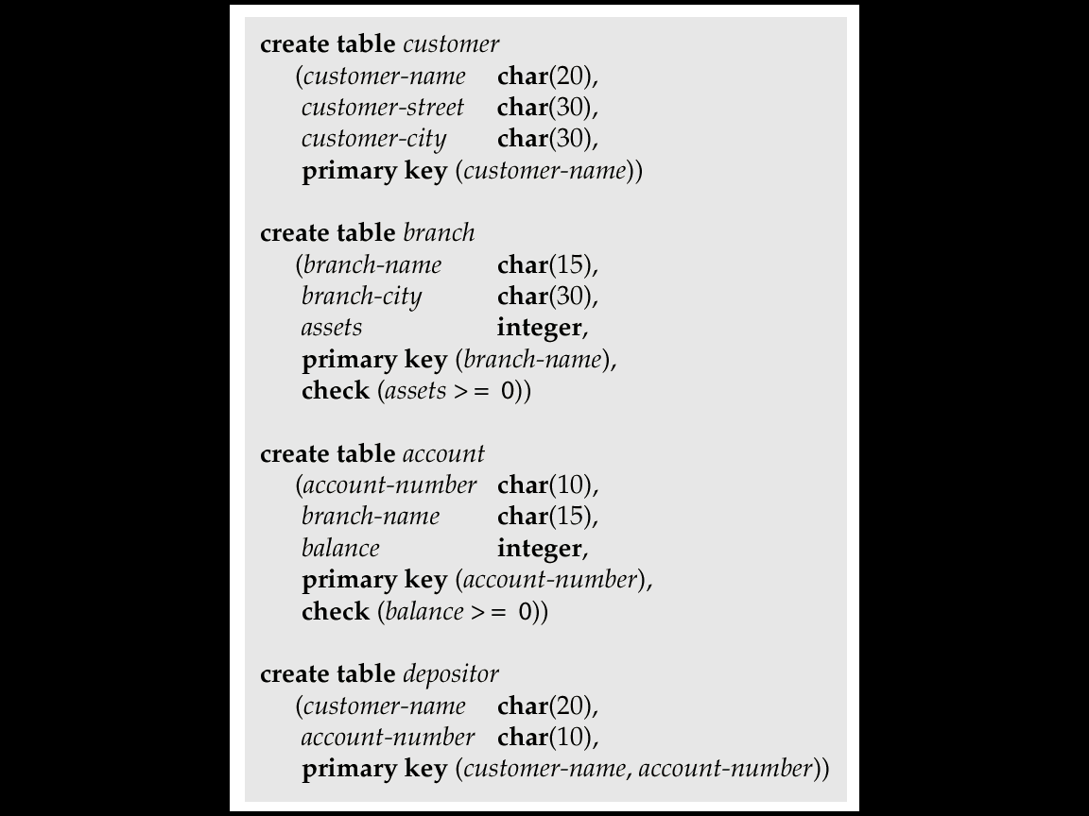
SQL Data Definition: Bank Database
2. customer
1. branch
3-<number>

Slide 10
3.2.1 Basic Domain Types
  char(n): Fixed length character string, with user-specified length n.
  varchar(n): Variable length, with user-specified maximum length n.
  int: Integer (a finite subset of the integers that is machine-dependent).
  smallint: Small integer (a machine-dependent)
  numeric(p,d): Fixed point number, with user-specified precision of p digits, with d digits to the right of decimal point.
  real, double precision: Floating point and double-precision floating point numbers, with machine-dependent precision.
  float(n): Floating point number, with user-specified precision of at least n digits.
  not null:
    Null values are allowed in all the domain types.
    Declaring an attribute to be not null prohibits null values for that attribute.
    create domain person-name char(20) not null
3-<number>
Notes:
？numeric()

Slide 11
Domain Types in SQL (cont.)
  date: Dates, containing a (4 digit) year, month and date
    E.g. date ‘2001-7-27’
  time: Time of day, in hours, minutes and seconds.
    E.g. time ’09:00:30’ time ’09:00:30.75’
  timestamp: date plus time of day
    E.g. timestamp ‘2001-7-27 09:00:30.75’
  interval: period of time or date
    Subtracting a date/time/timestamp value from another gives an interval value
      E.g. Suppose x and y are of type date, then x – y is an interval whose value is the number of days
    Interval values can be added to date/time/timestamp values
  extract: Can extract values of individual fields from date/time/timestamp
    E.g. extract (year from d) where d is value of a date
3-<number>

Slide 12
3.2.2 Basic Schema Definition in SQL
An SQL relation is defined using the create table command:
create table r (A₁ D₁, A₂ D₂, ..., A_{n} D_{n},
(integrity-constraint₁),
...,
(integrity-constraint_{k}))
  r is the name of the relation
  each A_{i} is an attribute name in the schema of relation r
  D_{i} is the data type of values in the domain of attribute A_{i}
  integrity-constraint₁
    not null
    primary key (A1, ..., An)
    check (P), where P is a predicate
3-<number>

Slide 13
Schema Definition: Example
Example: Declare branch-name as the primary key for branch and ensure that the values of assets are non-negative.
create table branch
(branch-name char(15),
branch-city char(30),
assets integer,
primary key (branch-name),
check (assets >= 0))
3-<number>

Slide 14
Schema Definition: Drop and Alter
drop table:
  The drop table command deletes all information about the dropped relation from the database. E.g. drop account
alter table:
  The alter table command is used to add attributes to an existing relation.
alter table r add A D
where A is the name of the attribute to be added to relation
r and D is the domain of A.
  All tuples in the relation are assigned null as the value for the new attribute.
  The alter table command can also be used to drop attributes of a relation
  alter table r drop A
  where A is the name of an attribute of relation r
  Dropping of attributes not supported by many databases
3-<number>

Slide 15
3.3 Basic Structure of SQL Queries
SQL is based on set and relational operations (ch. 2) with certain modifications and enhancements
A typical SQL query has the form:
select A₁, A₂, ..., A_{n}
from r₁, r₂, ..., r_{m}
where P
  A_{i}s represent attributes
  r_{i}s represent relations
  P is a predicate.
This query is equivalent to the relational algebra expression.
 Π_{A1, A2, ..., An}(σ_{P} (r₁ x r₂ x ... x r_{m}))
The result of an SQL query is a relation.
E.g. select loan-number
from loan
where branch-name = ‘Perryridge’
梨花崗山
3-<number>
Notes:
2

Slide 16
3.3.1 The select Clause
The select clause list the attributes desired in the result of a query
  corresponds to the projection operation of the relational algebra
E.g. find the names of all branches in the loan relation
select branch-name
from loan
In the “pure” relational algebra syntax, the query would be:
 _{branch-name}(loan)
5. loan
3-<number>
Notes:
3

Slide 17
The select Clause (cont.)
Note: SQL does not permit the ‘-’ character in names,
  Use, e.g., branch_name instead of branch-name in a real implementation.
  We use ‘-’ since it looks nicer!
Note: SQL names are case insensitive, i.e. you can use capital or small letters.
  You may wish to use upper case where-ever we use bold font.
3-<number>
Notes:
3
?中划线

Slide 18
The select Clause (cont.)
SQL allows duplicates in relations as well as in query results.
To force the elimination of duplicates, insert the keyword distinct after select.
Find the names of all branches in the loan relations, and remove duplicates
select distinct branch-name
from loan
The keyword all specifies that duplicates not be removed.
select all branch-name
from loan
5. loan
3-<number>
Notes:
4

Slide 19
The select Clause (cont.)
An asterisk in the select clause denotes “all attributes”
select *
from loan
The select clause can contain arithmetic expressions involving the operation, +, –, ∗, and /, and operating on constants or attributes of tuples.
  E.g.
select loan-number, branch-name, amount ∗ 100
from loan
  would return a relation which is the same as the loan relations, except that the attribute amount is multiplied by 100.
3-<number>
Notes:
5

Slide 20
3.3.2 The where Clause
The where clause specifies conditions that the result must satisfy
  corresponds to the selection predicate of the relational algebra.
To find all loan number for loans made at the Perryridge branch with loan amounts greater than $1200.
select loan-number
from loan
where branch-name = ‘Perryridge’ and amount > 1200
Comparison results can be combined using the logical connectives and, or, and not.
Comparisons can be applied to results of arithmetic expressions.
SQL includes a between comparison operator
select loan-number
from loan
where amount between 90000 and 100000
3-<number>
Notes:
6
？例子

Slide 21
3.3.3 The from Clause
The from clause lists the relations involved in the query
  corresponds to the Cartesian product operation of the relational algebra.
Find the Cartesian product: borrower x loan
select ∗
from borrower, loan
Find the name, loan number and loan amount of all customers having a loan at the Perryridge branch.
select customer-name, borrower.loan-number, amount
from borrower, loan
where borrower.loan-number = loan.loan-number and
branch-name = ‘Perryridge’
    p.50
Please include this query in EX
Please include this query in EX
3-<number>
Notes:
8

Slide 22
Example: Cartesian-Product
borrower x loan
6. borrower
5. loan
3-<number>

Slide 23
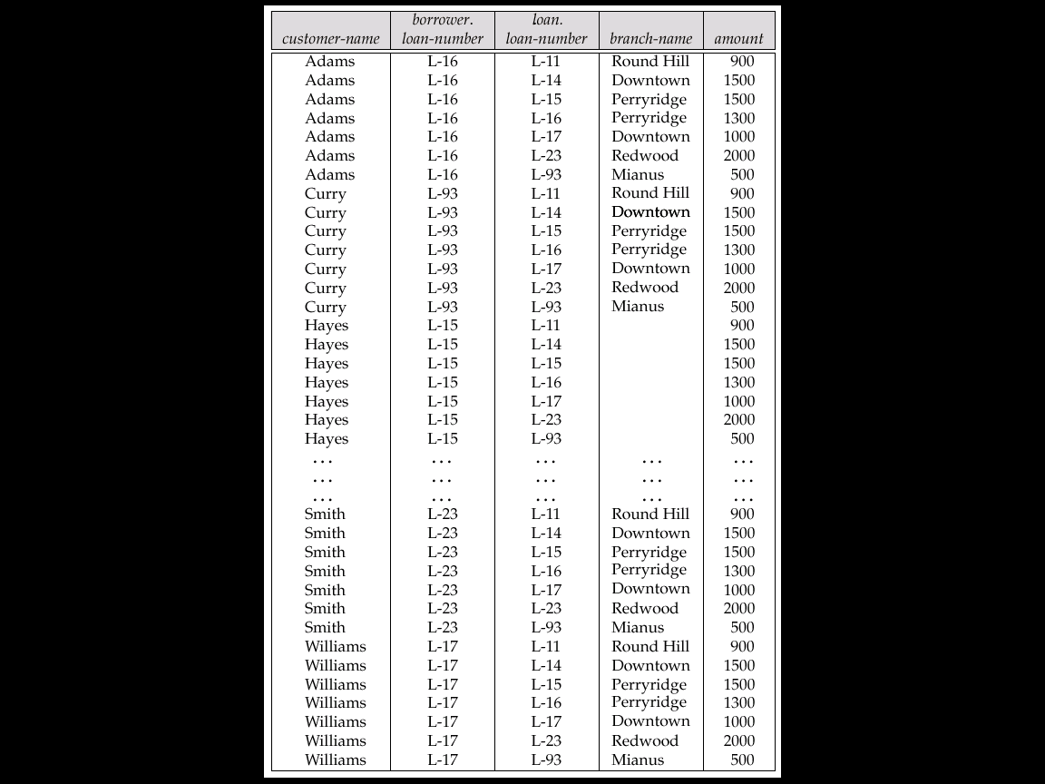
Example: borrower × loan (Fig. 2.13, p.50)
8 x 7 = 56 tuples
3-<number>

Slide 24
3.3.4 The rename Operation
The SQL allows renaming relations and attributes using the as clause:
old-name as new-name
Query: Find the name, loan number and loan amount of all customers; rename the column name loan-number as loan-id.
select customer-name, borrower.loan-number as loan-id, amount
from borrower, loan
where borrower.loan-number = loan.loan-number
customer-name
loan-id
amount
Please include this query in EX
3-<number>
Notes:
9

Slide 25
3.3.5 Tuple Variables
Tuple variables are defined in the from clause via the use of the as clause.
Query: Find the customer names and their loan numbers for all customers having a loan at some branch.
select customer-name, T.loan-number, S.amount
from borrower as T, loan as S
where T.loan-number = S.loan-number
T
5. loan
6. borrower
S
3-<number>
Notes:
10
？元组变量，元组结合变量

Slide 26
Tuple Variables (cont.)
Query: Find the names of all branches that have assets greater than
at least one branch located in Brooklyn.
select distinct T.branch-name
from branch as T, branch as S
where T.assets > S.assets and S.branch-city = ‘Brooklyn’
Please include this query in EX
1. branch
T
1. branch
S
branch-name
3-<number>
Notes:
10

Slide 27
3.3.6 String Operations
SQL includes a string-matching operator for comparisons on character strings. Patterns are described using two special characters:
  percent (%). The % character matches any substring.
  underscore (_ ). The _ character matches any character.
Query: Find the names of all customers whose street includes the substring “Main”.
select customer-name
from customer
where customer-street like ‘%Main%’
More Examples:
  ‘Perry%’ ➔ matches any string beginning with “Perry”
  ‘_ _ _’ ➔ matches any string of exactly three characters
  ‘_ _ _%’ ➔ matches any string of at least three characters
Please include this query in EX
3-<number>

Slide 28
String Operations (cont.)
Escape ‘\’
  like ‘Main\%’ escape ‘\’ ➔ Matches all string with “Main%”
  like ‘Main\\%’ escape ‘\’ ➔ Matches all string begin with “Main\”
String operations: SQL supports a variety of string operations such as
  concatenation (using “||”)
  converting from upper to lower case (and vice versa)
  finding string length, extracting substrings, etc.
3-<number>
Notes:
??? concatenation

Slide 29
3.3.7 Ordering the Display of Tuples
List in alphabetic order the names of all customers having a loan in Perryridge branch
select distinct customer-name
from borrower, loan
where borrower loan-number = loan.loan-number and
branch-name = ‘Perryridge’
order by customer-name
We may specify desc for descending order or asc for ascending order, for each attribute; ascending order is the default.
  E.g. order by customer-name desc
Please include this query in EX
3-<number>

Slide 30
3.3.8 Duplicates
In relations with duplicates, SQL can define how many copies of tuples appear in the result.
Example: Suppose multiset relations r₁ (A, B) and r₂ (C) are as follows:
r₁ = {(1, a) (2,a)} r₂ = {(2), (3), (3)}
  Then Π_{B}(r₁) would be {(a), (a)}, while Π_{B}(r₁) x r₂ would be
{(a,2), (a,2), (a,3), (a,3), (a,3), (a,3)}
SQL duplicate semantics:
select A₁,, A₂, ..., A_{n}
from r₁, r₂, ..., r_{m}
where P
is equivalent to the multiset version of the expression:
Π _{A1,, A2, ..., An}(σ_{P} (r₁ x r₂ x ... x r_{m}))
3-<number>

Slide 31
3.4 Set Operations
union, intersect, except:
  The set operations union并, intersect交, and except差 operate on relations and correspond to the relational algebra operations ∪, ∩, −.
  Each of the above operations automatically eliminates duplicates 自动去除重复;
union all, intersect all, except all:
  to retain all duplicates use the corresponding multiset versions union all, intersect all and except all.
  Suppose a tuple occurs m times in r and n times in s, then, it occurs:
    m + n times in r union all s
    min(m,n) times in r intersect all s
    max(0, m – n) times in r except all s
3-<number>

Slide 32
Set Operations (cont.)
Find all customers who have a loan, an account, or both:
(select customer-name from depositor)
union
(select customer-name from borrower)
Please include this query in EX
Find all customers who have both a loan and an account.
(select customer-name from depositor)
intersect
(select customer-name from borrower)
Find all customers who have an account but no loan.
(select customer-name from depositor)
except
(select customer-name from borrower)
3-<number>

Slide 33
3.5 Aggregate聚集 Functions
These functions operate on a set or multiset of values as input and return a single value.
  Input: a set
  Output: a single value
SQL offers five built-in functions:
  avg: average value
  min: minimum value
  max: maximum value
  sum: sum of values
  count: number of values
3-<number>

Slide 34
Aggregate Functions: Examples
Find the average account balance at the Perryridge branch.
select avg (balance)
from account
where branch-name = ‘Perryridge’
Find the number of tuples in the customer relation.
select count (*)
from customer
Please include this query in EX
Find the number of depositors in the bank.
select count (distinct customer-name)
from depositor
p.42
Please include this query in EX
3-<number>

Slide 35
Aggregate Functions: Group By and Having
Find the number of depositors for each branch.
select branch-name, count (distinct customer-name)
from depositor, account
where depositor.account-number = account.account-number
group by branch-name
Please include this query in EX
Find the names of all branches where the average account balance is more than $1,200.
select branch-name, avg (balance)
from account
group by branch-name
having avg (balance) > 1200
Please include this query in EX
3-<number>

Slide 36
3.6 Null Values
It is possible for tuples to have a null value, denoted by null, for some of their attributes
null signifies an unknown value or that a value does not exist.
The predicate is null can be used to check for null values.
  E.g. Find all loan number which appear in the loan relation with null values for amount.
select loan-number
from loan
where amount is null
The result of any arithmetic expression involving null is null
  e.g. 5 + null returns null
However, aggregate functions simply ignore nulls
3-<number>

Slide 37
Null Values (cont.)
Any comparison with null returns unknown
  E.g. 5 < null or null <> null or null = null
Three-valued logic using the truth value unknown:
  or: (unknown or true) = true, (unknown or false) = unknown
  (unknown or unknown) = unknown
  and: (true and unknown) = unknown,
  (false and unknown) = false,
  (unknown and unknown) = unknown
  not: (not unknown) = unknown
  “P is unknown” evaluates to true if predicate P evaluates to unknown
Result of where clause predicate is treated as false if it evaluates to unknown
3-<number>

Slide 38
Null Values and Aggregates
Total all loan amounts
select sum (amount)
from loan
  Above statement ignores null amounts
  result is null if there is no non-null amount
  All aggregate operations except count(*) ignore tuples with null values on the aggregated attributes.
3-<number>

Slide 39
3.7 Nested嵌套 Subqueries
SQL provides a mechanism for the nesting of subqueries.
Subquery: A subquery is a select-from-where expression that is nested within another query.
A common use of subqueries is to perform tests for
  set membership 集合成员资格
  set comparisons 集合比较
  set cardinality 集合基数检查
3-<number>

Slide 40
3.7.1 Set Membership
6. borrower
Find all customers who have both an account and a loan at the bank.
select distinct customer-name
from borrower
where customer-name in (select customer-name
from depositor)
方法二: ???
4. depositor
Find all customers who have a loan at the bank but do not have an account at the bank
select distinct customer-name
from borrower
where customer-name not in (select customer-name
from depositor)
3-<number>

Slide 41
Set Membership (cont.)
Find all customers who have both an account and a loan at the Perryridge branch
select distinct customer-name
from borrower, loan
where borrower.loan-number = loan.loan-number and
branch-name = “Perryridge” and
(branch-name, customer-name) in
(select branch-name, customer-name
from depositor, account
where depositor.account-number =
account.account-number)
Note: Above query can be written in a much simpler manner. The
formulation above is simply to illustrate SQL features.
3-<number>

Slide 42
3.7.2 Set Comparison
Find all branches that have greater assets than some branch located in Brooklyn.
1. branch
方法一: Using rename
select distinct T.branch-name
from branch as T, branch as S
where T.assets > S.assets and
S.branch-city = ‘Brooklyn’
方法二: Using > some clause
select branch-name
from branch
where assets > some
(select assets
from branch
where branch-city = ‘Brooklyn’)
Please include this query in EX
3-<number>

Slide 43
Definition of some Clause
F <comp> some r ⇔ ∃ t ∈ r s.t. (F <comp> t)
where <comp> can be: <, ≤, >, =, ≠
0
(5< some
5
) = true
(read: 5 < some tuple in the relation)
6
0
(5< some
5
) = false
0
(5 = some
) = true
5
0
(5 ≠ some
5
) = true (since 0 ≠ 5)
(= some) ≡ in
However, (≠ some) ≡ not in
3-<number>

Slide 44
Definition of all Clause
F <comp> all r ⇔ ∀ t ∈ r (F <comp> t)
0
(5< all
) = false
5
6
6
(5< all
) = true
10
4
(5 = all
) = false
5
4
(5 ≠ all
) = true (since 5 ≠ 4 and 5 ≠ 6)
6
(≠ all) ≡ not in
However, (= all) ≡ in
3-<number>

Slide 45
Example Query: all
Find the names of all branches that have greater assets than all branches located in Brooklyn.
select branch-name
from branch
where assets > all
(select assets
from branch
where branch-city = ‘Brooklyn’)
1. branch
Please include this query in EX
3-<number>

Slide 46
3.7.3 Test for Empty Relations
The exists construct returns the value true if the argument subquery is nonempty.
  exists r ⇔ r ≠ Ø
  not exists r ⇔ r = Ø
3-<number>

Slide 47
Example Query: exists
?
Find all customers who have an account at all branches located in Brooklyn.
// test Hayes, Johnson, … one-by-one
select distinct S.customer-name
from depositor as S
where not exists (
(select branch-name
from branch
where branch-city = ‘Brooklyn’)
except
(select R.branch-name
from depositor as T, account as R
where T.account-number = R.account-number and
S.customer-name = T.customer-name))
// Find all branches in Brooklyn
{Brighton, Downtown}
(Schema used in this example)
Note that X – Y = Ø ⇔ X ⊆ Y
Note: Cannot write this query using = all and its variants
3-<number>

Slide 48
Find all customers who have an account at all branches located in Brooklyn.
3. account
// Find all branches in Brooklyn
(select branch-name
from branch
where branch-city = ‘Brooklyn’)
{Brighton, Downtown}
4. depositor
1. branch
3-<number>

Slide 49
// Find all branches at which customer S.customer-name has an account.
// Find all branches at which customer S.customer-name has an account.
(select R.branch-name
from depositor as T, account as R
where T.account-number = R.account-number and
S.customer-name = T.customer-name))
4. depositor, T
3. account, R
S
3-<number>

Slide 50
3.7.4 Test for Absence of Duplicate Tuples
测试是否存在重复元组
The unique construct tests whether a subquery has any duplicate tuples in its result.
Find all customers who have at most one account at the Perryridge branch.
select T.customer-name
from depositor as T
where unique (
select R.customer-name
from account, depositor as R
where T.customer-name = R.customer-name and
R.account-number = account.account-number and
account.branch-name = ‘Perryridge’)
(Schema used in this example)
3-<number>
Notes:
结束四周？

Slide 51
Example Query: unique
Find all customers who have at least two accounts at the Perryridge branch.
select distinct T.customer-name
from depositor T
where not unique (
select R.customer-name
from account, depositor as R
where T.customer-name = R.customer-name and
R.account-number = account.account-number and
account.branch-name = ‘Perryridge’)
(Schema used in this example)
3-<number>

Slide 52
3.8 Complex Queries 复杂查询
Derived Relations
The with Clause
衍生
select branch-name, avg (balance)
from account
group by branch-name
as result (branch-name, avg-balance)
3. account
result
branch-name
avg-balance
A derived relation
3-<number>

Slide 53
3.8.1 Derived Relations派生关系
Find the average account balance of those branches where the average account balance is greater than $500
select branch-name, avg-balance
from (select branch-name, avg (balance)
from account
group by branch-name)
as result (branch-name, avg-balance)
where avg-balance > 500
Note:
  result: is a derived relations, a temporary (view) relation
  the attributes of result can be used directly in the where clause.
3. account
Please include this query in EX
3-<number>
Notes:
??例子

Slide 54
3.8.2 The with Clause
with clause: (introduced in SQL:1999)
  create view clause crates a view definition in the database, globally.
  with clause creates a temporary view locally to a query in which the with clause occurs.
  Analogous to procedures in a programming language.
Example 1: Find all accounts with the maximum balance
vs. Codd, 1970
3. account
with max-balance (value) as
select max(balance)
from account
select account-number
from account, max-balance
where account.balance = max-balance.value
max-balance
???
value
account-number
Please include this query in EX ??
900
3-<number>
Notes:
下课

Slide 55
The with Clause: Example 2
Example 2: Find all branches where the total account deposit is greater than the average of the total account deposits at all branches.
with branch-total (branch-name, value) as
select branch-name, sum (balance)
from account
group by branch-name
with branch-total-avg(value) as
select avg (value)
from branch-total
select branch-name
from branch-total, branch-total-avg
where branch-total.value >= branch-total-avg.value
3-<number>

Slide 56
3.9 Views 视图
Provide a mechanism to hide certain data from the view of certain users. To create a view we use the command:
create view v as <query expression>
e.g. 1. create view big-customer as
(select account-number, branch-name
from account
where balance > 500
e.g. 2. select *
from big-customer
Please include this query in EX
3. account,
big-customer
3-<number>

Slide 57
Views (補)
Virtual table (doesn't really exist )
No stored file
Definition of view is stored in system catalog
A base table may be stored in several files
A file may contain several base tables
A view may be derived from several
base tables
A base table may derive several views
SQL
View V1
View V2
Base
Table B1
Base
Table B2
Base
Table B3
Base
Table B4
Data Set
D1
Data Set
D2
Data Set
D3
Data Set
D4
3-<number>

Slide 58
Example Queries: view
A view consisting of branches and their customers
create view all-customer as
(select branch-name, customer-name
from depositor, account
where depositor.account-number = account.account-number)
union
(select branch-name, customer-name
from borrower, loan
where borrower.loan-number = loan.loan-number)
Find all customers of the Perryridge branch
select customer-name
from all-customer
where branch-name = ‘Perryridge’
3-<number>

Slide 59
Example: Banking Database
1. branch
2. customer
3. depositor
分公司
客戶(存款戶,貸款戶)
存款戶
4. borrower
貸款戶
5. account
存款帳
6. loan
貸款帳
3-<number>

Slide 60
Example Queries: view (cont.)
4. depositor
3. account
all-customer
create view all-customer as
(select branch-name, customer-name
from depositor, account
where depositor.account-number
= account.account-number)
Branch-name
Customer-name
Perryridge
Downtown
…
Hays
Johnson
…
3-<number>

Slide 61
3.10 Modification of the Database
Deletion
Insertion
Updates
Update of a View
Transactions
  Commit
  Rollback
3-<number>

Slide 62
3.10.1 Deletion
Example 1: Delete all account records at the Perryridge branch
delete from account
where branch-name = ‘Perryridge’
Example 2: Delete all accounts at every branch located in Needham city.
delete from account
where branch-name in (select branch-name
from branch
where branch-city = ‘Needham’)
Please include this query in EX
3. account
1. branch
3-<number>

Slide 63
Deletion: Example 3
Example 3: Delete the record of all accounts with balances below the average at the bank.
  Problem: as we delete tuples from account, the average balance changes
  Solution used in SQL:
  1. First, compute avg balance and find all tuples to delete
  2. Next, delete all tuples found above (without recomputing avg or
  retesting the tuples)
3. account
delete from account
where balance < (select avg (balance)
from account)
3-<number>

Slide 64
3.10.2 Insertion
Add a new tuple to account
insert into account
values (‘A-9732’, ‘Perryridge’,1200)
or equivalently
insert into account (branch-name, balance, account-number)
values (‘Perryridge’, 1200, ‘A-9732’)
Add a new tuple to account with balance set to null
insert into account
values (‘A-777’,‘Perryridge’, null)
3. account
3-<number>

Slide 65
Insertion (cont.)
Provide as a gift for all loan customers of the Perryridge branch, a $200 savings account. Let the loan number serve as the account number for the new savings account
The select from where statement is fully evaluated before any of its results are inserted into the relation (otherwise queries like
insert into table1 select * from table1
would cause problems
insert into account
select loan-number, branch-name, 200
from loan
where branch-name = ‘Perryridge’
insert into depositor
select customer-name, loan-number
from loan, borrower
where branch-name = ‘Perryridge’
and loan.account-number = borrower.account-number
3-<number>
Notes:
???

Slide 66
Example: Banking Database
1. branch
2. customer
3. depositor
分公司
客戶(存款戶,貸款戶)
存款戶
4. borrower
貸款戶
5. account
存款帳
6. loan
貸款帳
3-<number>

Slide 67
3.10.3 Updates
Increase all accounts with balances over $10,000 by 6%, all other accounts receive 5%.
  Write two update statements:
  update account
  set balance = balance ∗ 1.06
  where balance > 10000
  update account
  set balance = balance ∗ 1.05
  where balance ≤ 10000
  The order is important
  Can be done better using the case statement (next slide)
3-<number>

Slide 68
Case Statement for Updates
Same query as before: Increase all accounts with balances over $10,000 by 6%, all other accounts receive 5%.
update account
set balance = case
when balance <= 10000 then balance *1.05
else balance * 1.06
end
Please include this query in EX
3-<number>

Slide 69
3.10.4 Update of a View
Example: Create a view of all loan data in loan relation, hiding the amount attribute
create view branch-loan as
select branch-name, loan-number
from loan
  Add a new tuple to branch-loan
insert into branch-loan
values (‘Perryridge’, ‘L-307’)
  This insertion must be represented by the insertion of the tuple
(‘L-307’, ‘Perryridge’, null)
into the loan relation
5. loan
L-307 Perryridge null
branch-loan
view
branch-name
loan-number
Perryridge’, ‘L-307
3-<number>

Slide 70
Update of a View (cont.)
Updates on more complex views are difficult or impossible to translate, and hence are disallowed.
Most SQL implementations allow updates only on simple views (without aggregates) defined on a single relation
create view result as
select branch-name, avg (balance) as avg-balance
from account
group by branch-name
3. account
result
branch-name
avg-balance
Brighton 825
3-<number>

Slide 71
3.10.5 Transactions
Motivating Example:
  Consider: Transfer of money from one account to another involves two steps:
    deduct from one account and
    credit to another
  Problem: If one steps succeeds and the other fails, database is in an inconsistent state
  Solution: either both steps should succeed or neither should
Undo: If any step of a transaction fails, all work done by the transaction can be undone by rollback work.
Rollback of incomplete transactions is done automatically, in case of system failures
3-<number>

Slide 72
Transactions (cont.)
Transaction: A transaction is a sequence of queries and update statements executed as a single unit
  Transactions are started implicitly and terminated by one of
    commit work: makes all updates of the transaction permanent in the database (write buffer out to disk)
    rollback work: undoes all updates performed by the transaction
In most database systems, each SQL statement that executes successfully is automatically committed.
  Each transaction would then consist of only a single statement
  Automatic commit can usually be turned off, allowing multi-statement transactions, but how to do so depends on the database system
  Another option in SQL:1999: enclose statements within
  begin atomic
  …
  end
3-<number>
Notes:
？？？

Slide 73
3.11 Joined Relations
Join operations take two relations and return as a result another relation.
These additional operations are typically used as subquery expressions in the from clause
Join condition – defines which tuples in the two relations match, and what attributes are present in the result of the join.
Join type – defines how tuples in each relation that do not match any tuple in the other relation (based on the join condition) are treated.
Join Types
Join Conditions
inner join
left outer join
right outer join
full outer join
natural
on <predicate>
using (A₁, A₂, ..., A_{n})
3-<number>

Slide 74
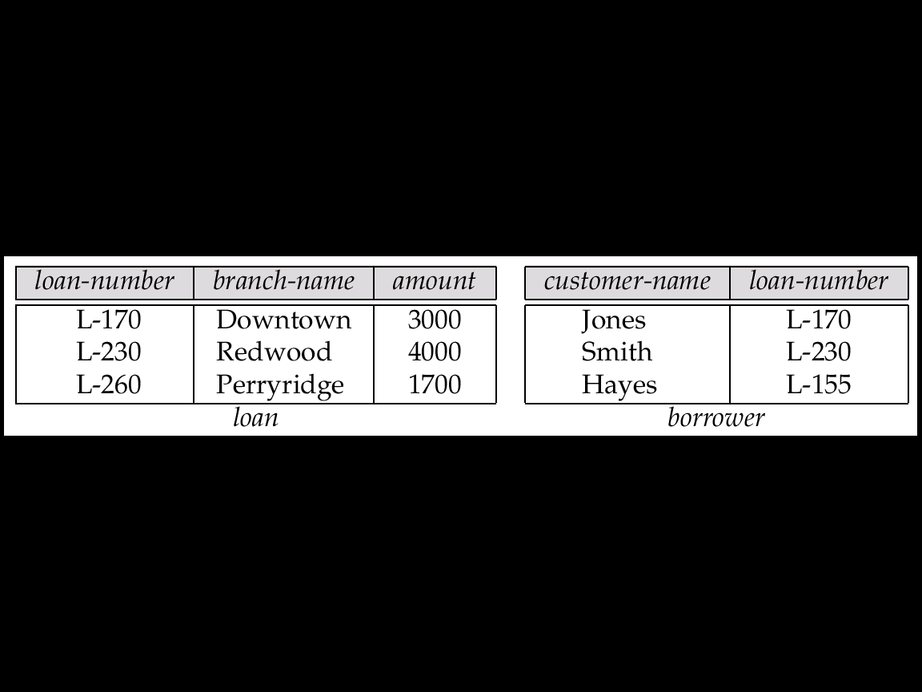
Fig. 4.1 The loan and borrower Relations
Joined Relations: Example (Datasets)
3-<number>

Slide 75
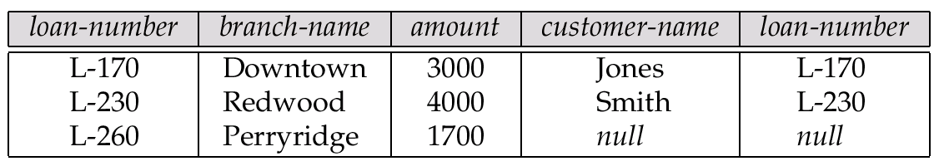
Fig. 4.2 The Result of loan inner join borrower on loan.loan-number = borrower.loan-number
Example: inner join
3-<number>

Slide 76
Fig. 4.3 The Result of loan left outer join borrower on loan-number
Example: left outer join
3-<number>
Notes:
???

Slide 77
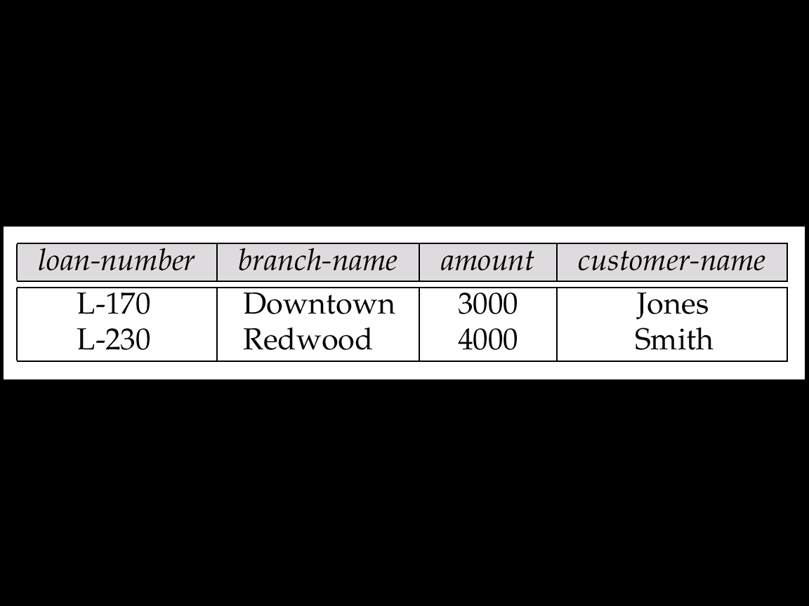
Fig. 4.4 The Result of loan natural inner join borrower
Example: natural inner join
3-<number>

Slide 78
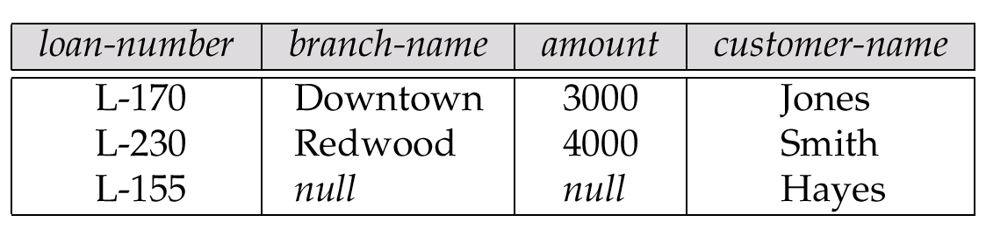
Fig. 4.6 The Result of loan natural right outer join borrower
Example: natural right outer join
3-<number>

Slide 79
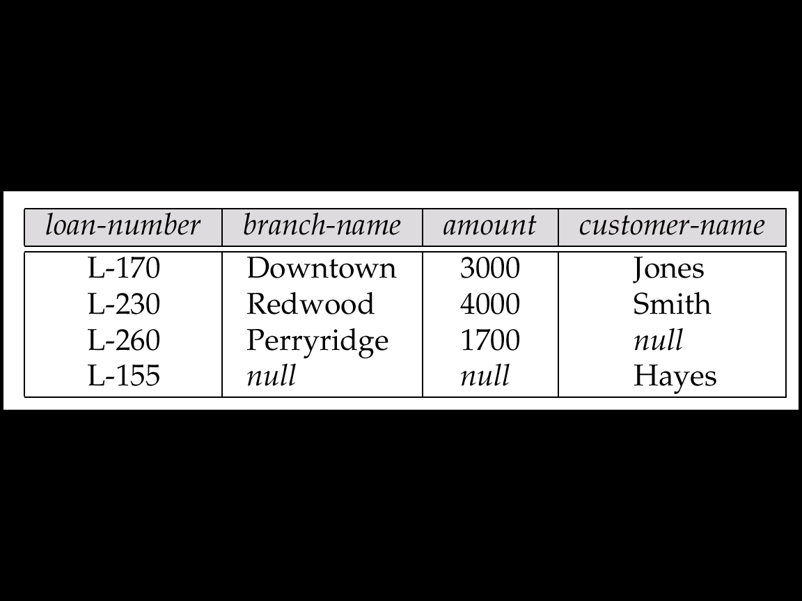
Fig. 4.7 The Result of loan full outer join borrower using (loan-number)
Example: full outer join
3-<number>

Slide 80
Example: Banking Database
1. branch
2. customer
3. depositor
分公司
客戶(存款戶,貸款戶)
存款戶
4. borrower
貸款戶
5. account
存款帳
6. loan
貸款帳
3-<number>

